Slide 1
Race, English Proficiency, and Housing Affordability: Unpacking Baltimore Housing Crisis
Group 5
Tim Barrows, Noah Carey, Joseph Wong, Caleb Fan

Slide 2
Objective
Housing affordability is a major concern in the current housing market, and we want to see what indicators there are for individuals who may not be able to afford housing.
Due to race typically being an indication of lack of housing affordability, we chose to look at race (nonwhite minorities), hispanic percentage and lack of English proficiency.
We used housing cost burden as our indicator for housing affordability.

Slide 3
Research Question and Hypothesis
What are the interactions between race, English proficiency, and housing cost burden?
We predicted that there would be a strong correlation race and lack of English proficiency.
We also expected a strong correlation between race and housing cost burden.

Slide 4
Methodology
Excel: SVI data was observed and basic cleaning was conducted
R Studio: Data exploration, correlation analysis, and multilinear regression analysis of the specified variables
Tableau: Data visualization and dashboard creation

Slide 5
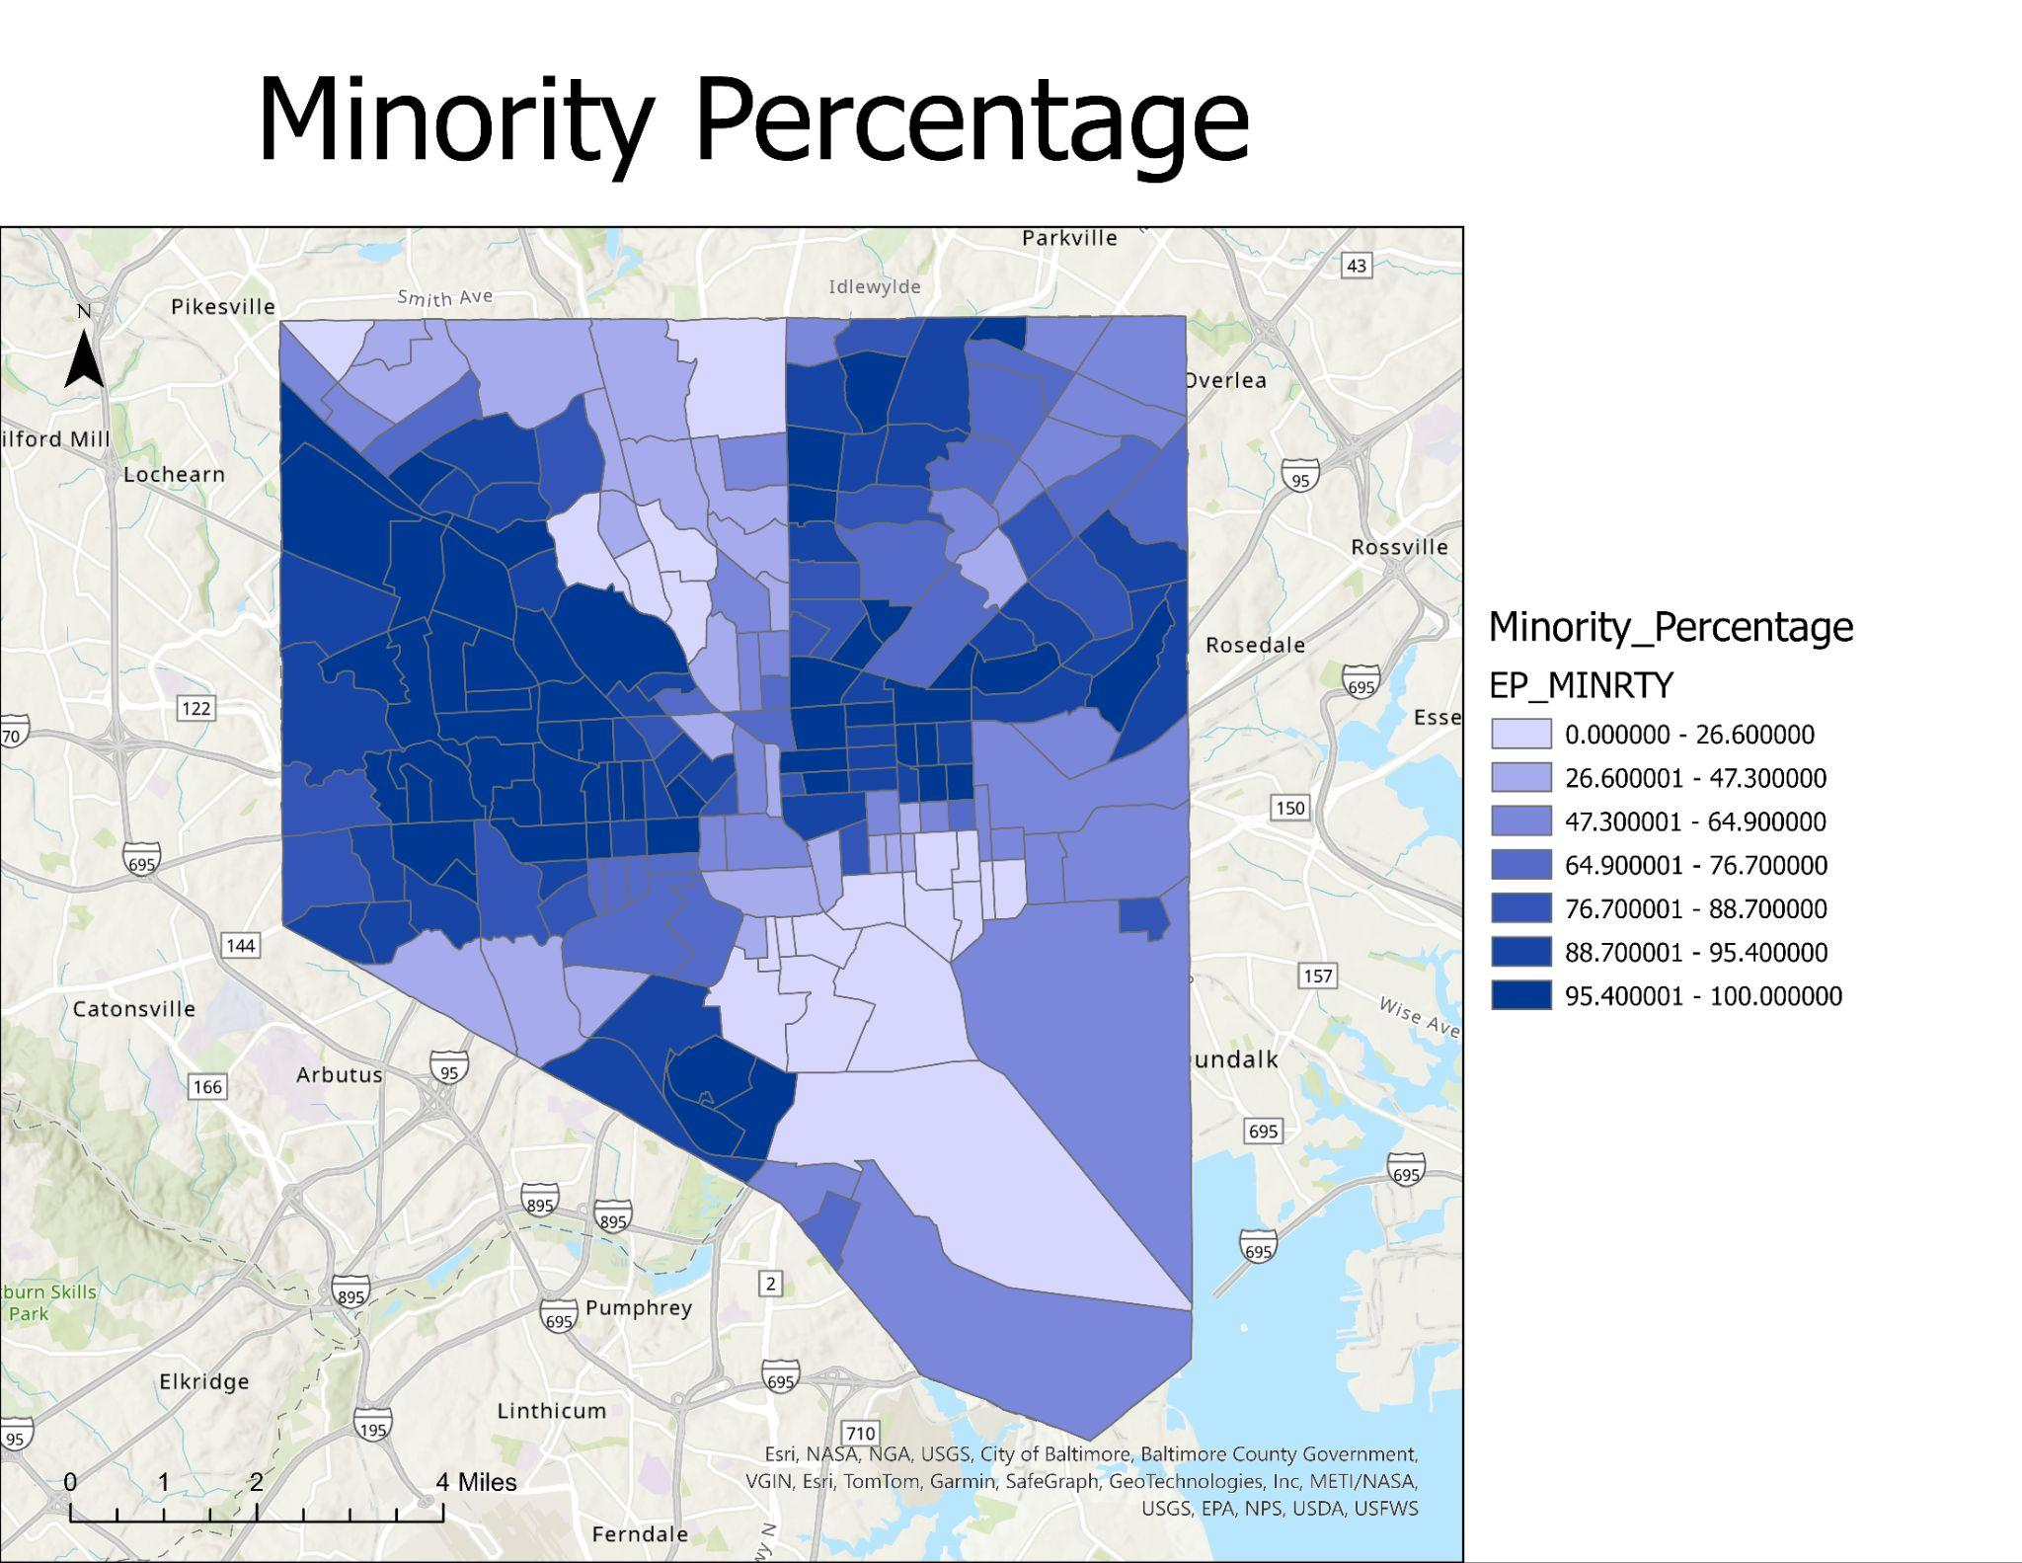
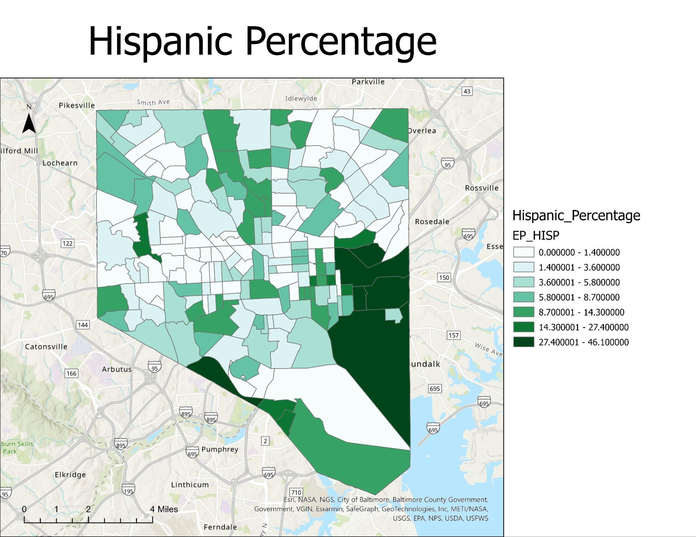
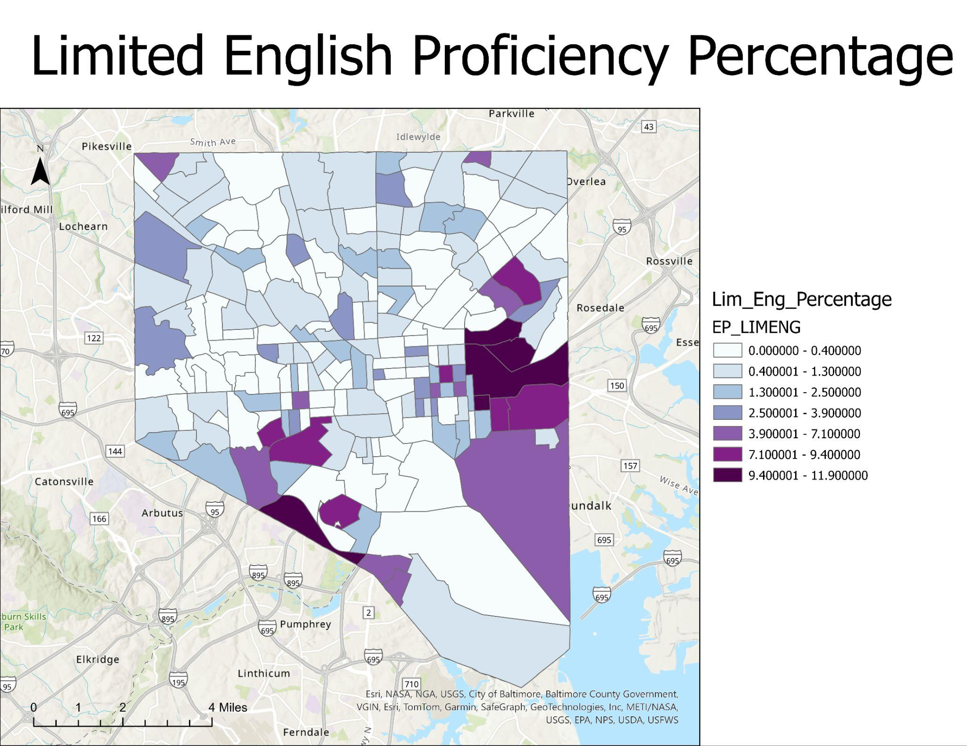
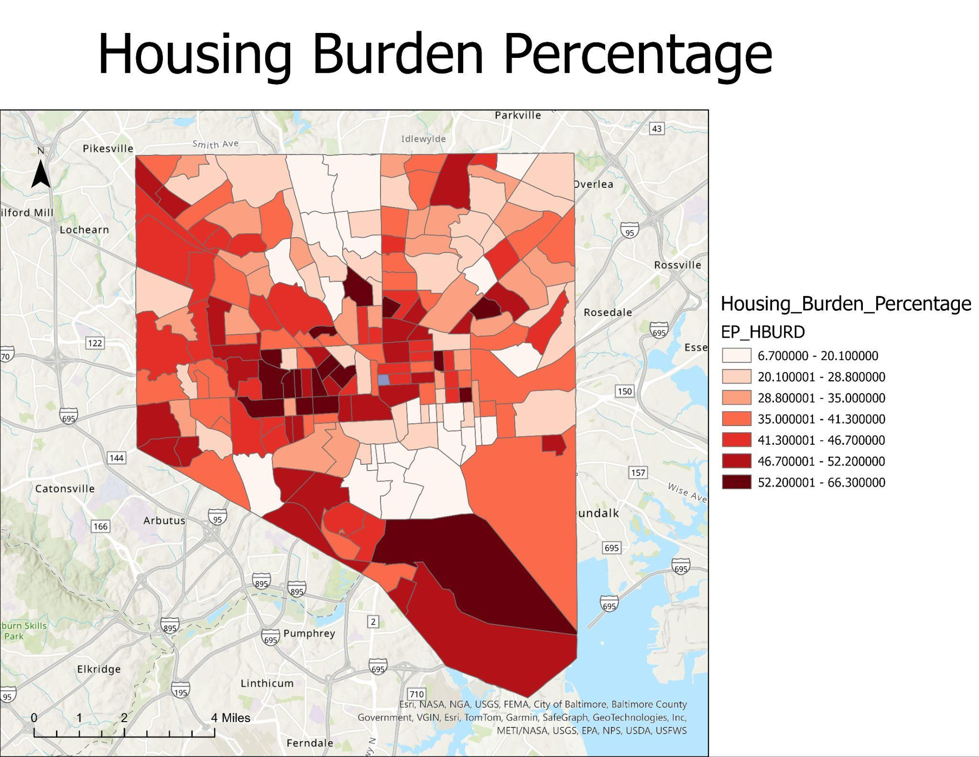

Slide 6
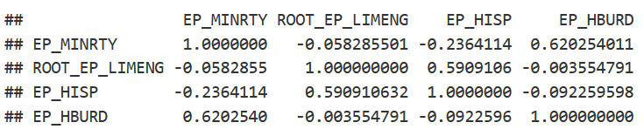
Results
No correlation between English Proficiency and Housing Burden
Moderate correlation between Percent Minority and Housing Burden
No correlation between between Hispanic Percentage and Housing Burden

Slide 7
Limitations
“Minorities” are not minorities in Baltimore
Presumptions of English proficiency and race
Housing cost burden is not a perfect analog for housing affordability

Slide 8
Conclusion
As expected, race can be an indicator for a lack of housing affordability.
A lack of English proficiency does not serve as an indicator for housing affordability.
Greater Hispanic Percentage does not serve as an indicator for housing affordability
Housing cost burden may not serve as the best stand in for housing affordability, a subsequent investigation should use another metric.
More variables are required to enhance analysis

Slide 9
Questions?

